Slide 1



DevOps and Continuous Delivery
Reference Architectures
Volume 2
Derek E. Weeks (@weekstweets)
VP and DevOps Advocate
Sonatype

Slide 2












Common Elements of the Software Supply Chain
Notes:
Continuous Delivery and DevOps Reference Architectures include many common tool choices. The most common tool choices we find in these reference architectures are: Eclipse, git, Cloudbees Jenkins / Atlassian Bamboo, Sonatype Nexus, Atlassian JIRA, SonarQube, Puppet, Chef, Rundeck, Maven / Ant / Gradle, Subversion (svn), Junit, LiveRebel, ServiceNow

Slide 3

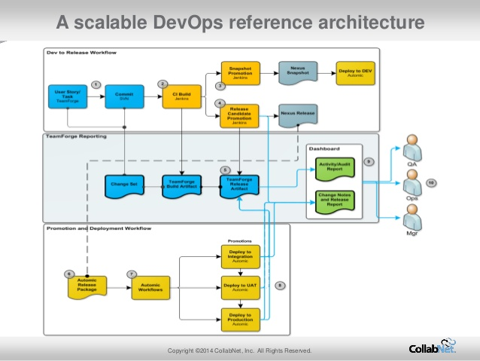
According to CollabNet
http://www.slideshare.net/collabNet/achieving-devops-using-open-source-tools-in-the-enterprise
Notes:
Continuous Delivery and DevOps Reference Architectures include many common tool choices. The most common tool choices we find in these reference architectures are: Eclipse, git, Cloudbees Jenkins / Atlassian Bamboo, Sonatype Nexus, Atlassian JIRA, SonarQube, Puppet, Chef, Rundeck, Maven / Ant / Gradle, Subversion (svn), Junit, LiveRebel, ServiceNow

Slide 4
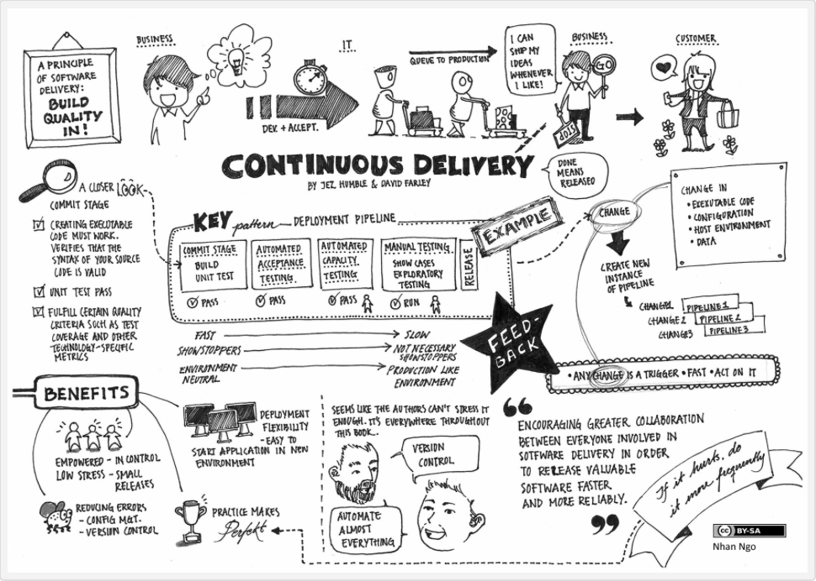
According to Nhan Ngo
Source: http://continuousdelivery.com

Slide 5
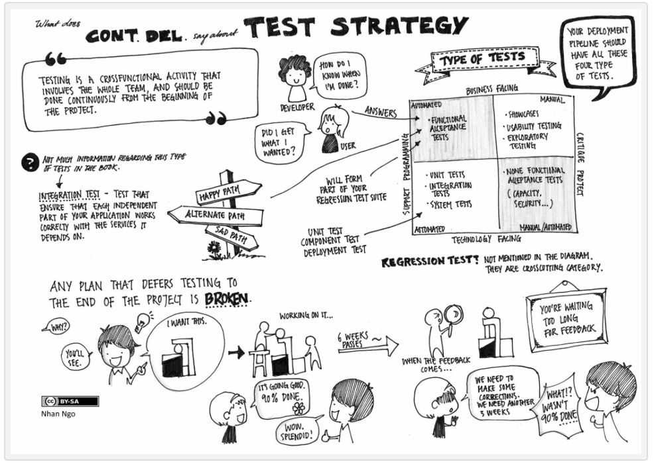
According to Nhan Ngo
Source: http://continuousdelivery.com

Slide 6
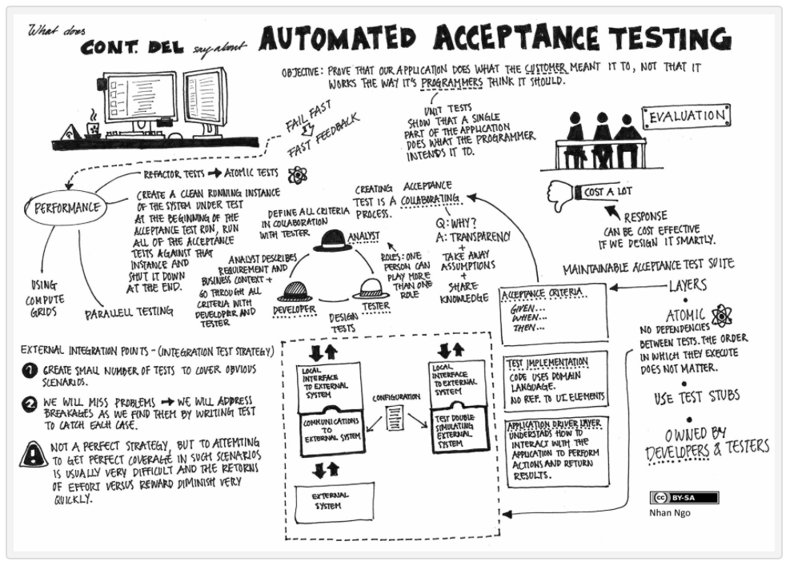
According to Nhan Ngo
Source: http://continuousdelivery.com

Slide 7
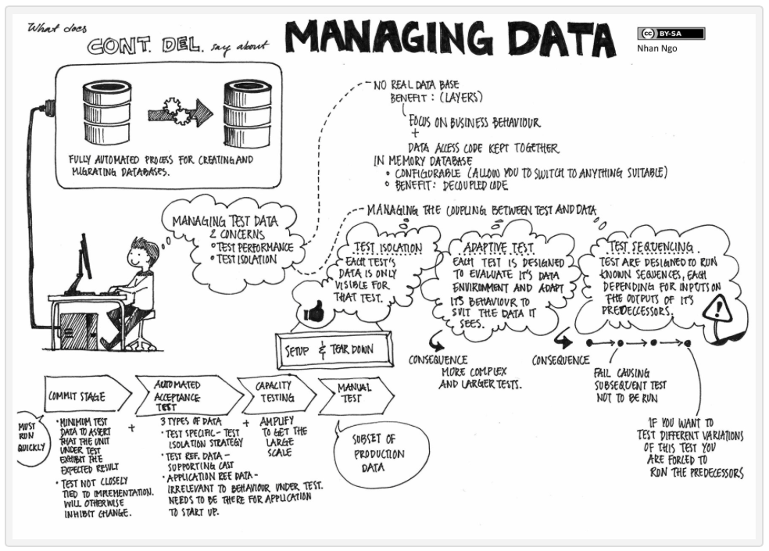
According to Nhan Ngo
Source: http://continuousdelivery.com

Slide 8

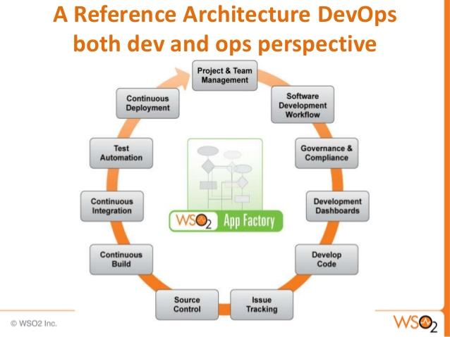
According to WS02
Source: http://www.slideshare.net/cobiacomm/driving-enterprise-architecture-redesign-cloudnative-platforms-apis-and-devops

Slide 9

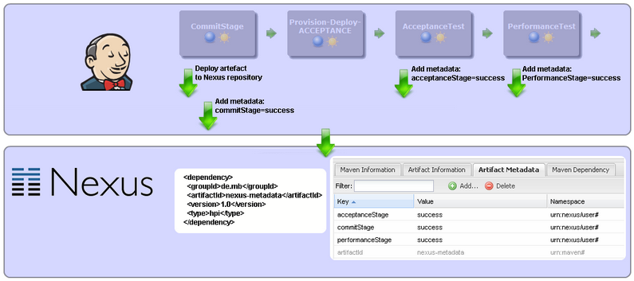
According to CodeCentric
Source: https://blog.codecentric.de/en/2012/08/tutorial-create-a-jenkins-plugin-to-integrate-jenkins-and-nexus-repository/

Slide 10
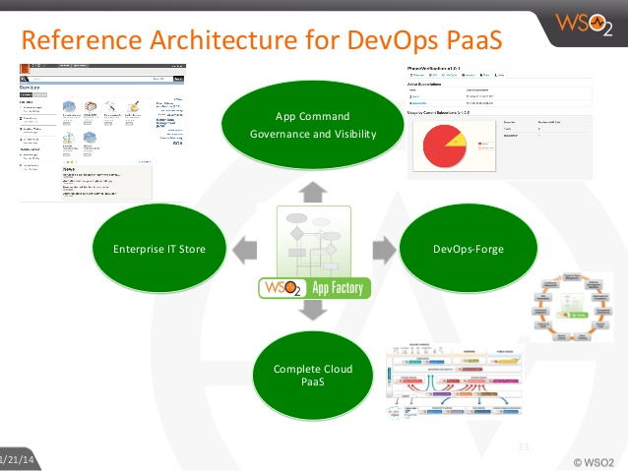
According to WS02
Source: http://www.slideshare.net/wso2.org/2014-01reshaping-ea

Slide 11
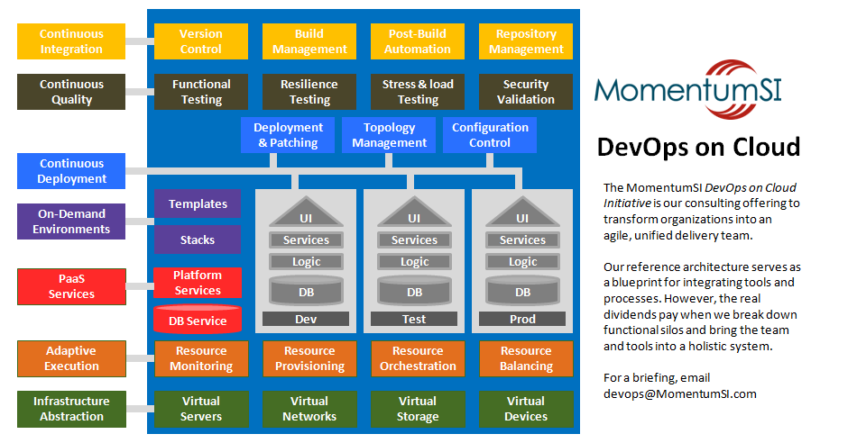
According to Momentum SI
Source: http://www.momentumsi.com/devops-implementations/

Slide 12
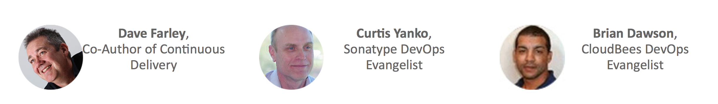

Learn from the Experts on October 1, 2015
RSVP Today
@ bit.ly/DevOpsTrio
For any enterprise implementation of DevOps or Continuous Delivery, it is important to have a reference architecture and pipeline defined. Learn from their best practices for securing new investments, driving process changes, and selecting tools to support their software factories.
Curtis Yanko
DevOps Coach,
Sonatype
Former Architecture Manager,
DevOps Center of Excellence
@OnCommit
Dave Farley
Founder and Director,
Continuous Delivery Ltd.
Co-Author of
Continuous Delivery
@davefarley77
Brian Dawson
DevOps Evangelist,
CloudBees
Former Manager,
Enterprise Agile Transformation Practice
CollabNet
@BrianVDawson

Slide 13
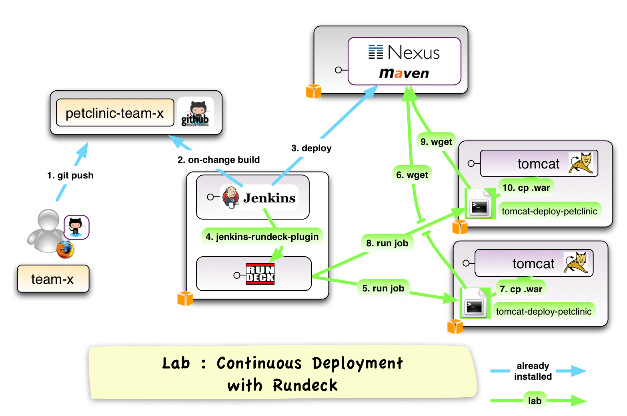
According to Goobbe
Source: http://goobbe.com/questions/7339261/how-can-we-execute-jenkins-job-using-other-user-credential

Slide 14

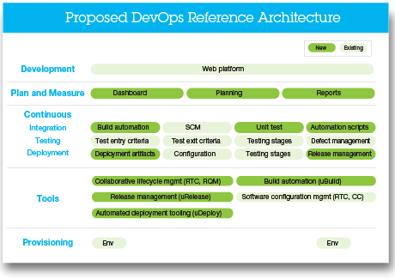
According to IBM
Source: http://www-935.ibm.com/services/us/gbs/online/devops.html

Slide 15
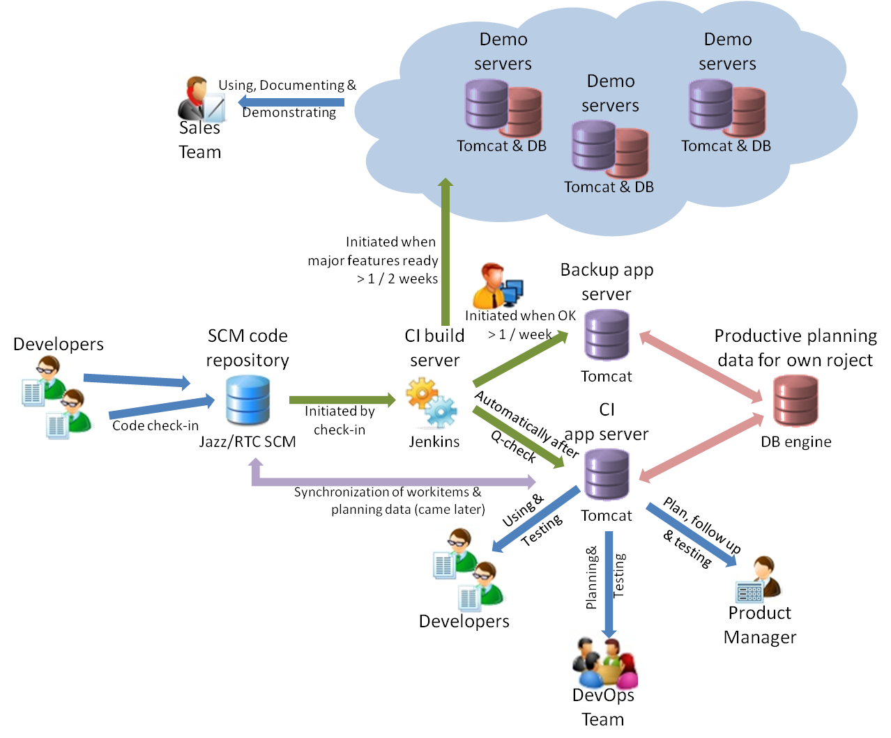
According to IBM
Source: https://www.ibm.com/developerworks/community/blogs/c914709e-8097-4537-92ef-8982fc416138/entry/we_reach_our_goal_with_devops?lang=en

Slide 16
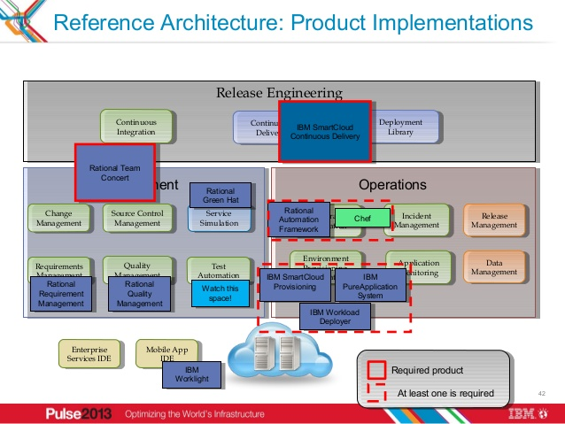
According to IBM
Source: http://www.slideshare.net/sanjeev-sharma/ibm-pulse-2013-session-devops-for-mobile-apps

Slide 17
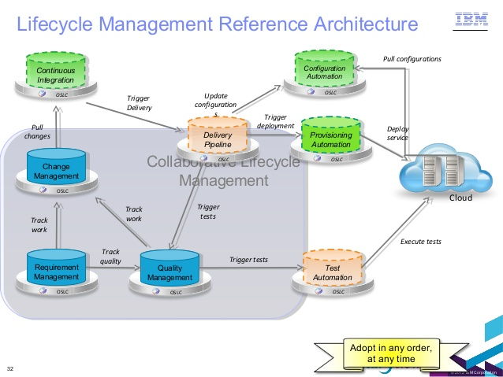
According to IBM
Source: http://www.slideshare.net/MichaelElder/cdo-1426-trends-and-future-for-dev-opsv51

Slide 18

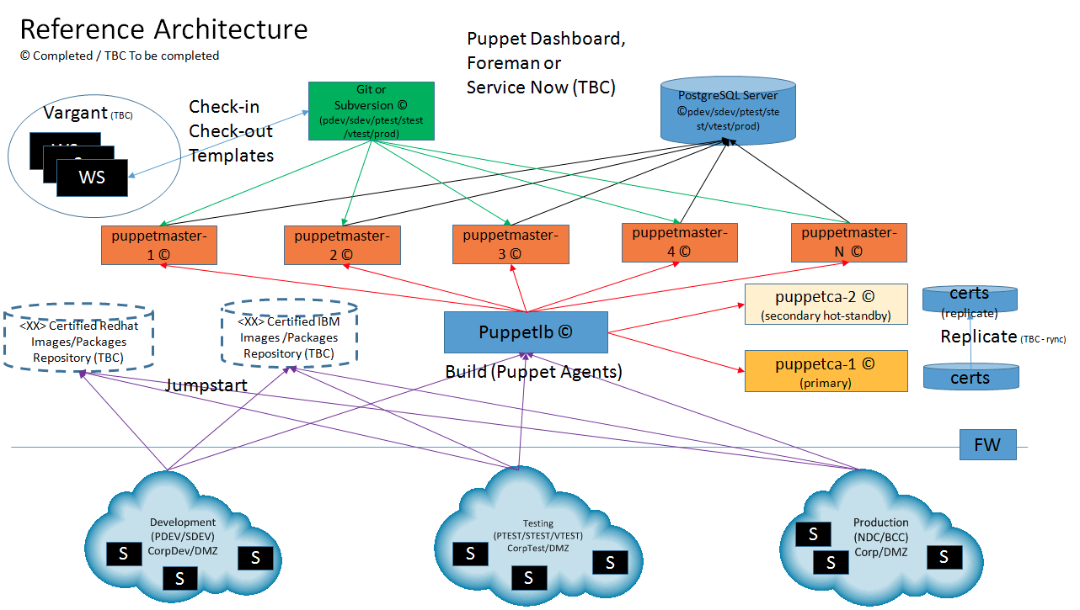
According to OZsofts
Source: http://www.ozsofts.com/?p=15

Slide 19

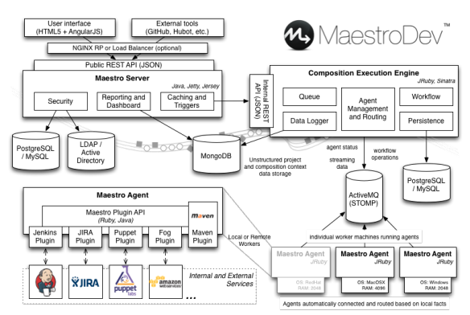
According to MaestroDev
Source: http://java.dzone.com/articles/anatomy-devops-orchestration

Slide 20

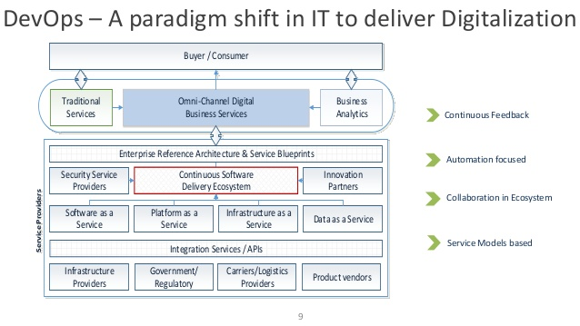
According to The Open Group
Source: http://www.slideshare.net/akr2010/blueprinting-devops-for-digital-transformationv4

Slide 21

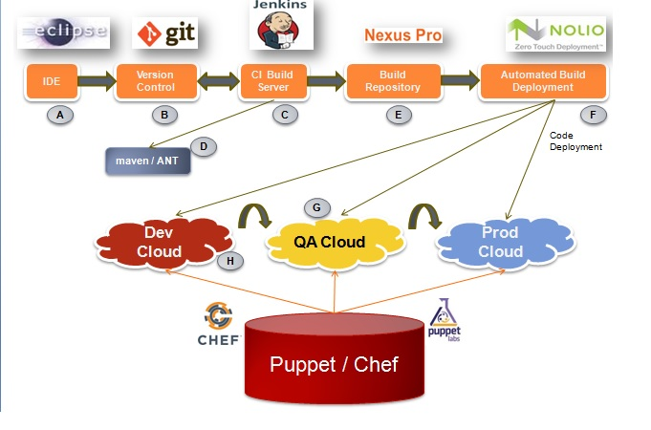
According to AgileTrick
Source: http://agiletrick.com/devops/architecture-of-devops/

Slide 22

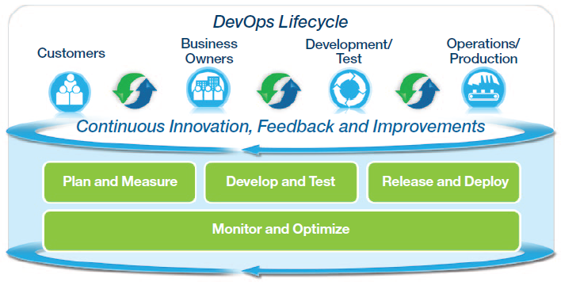
According to DevOps by Design
Source: http://www.devopsbydesign.com

Slide 23
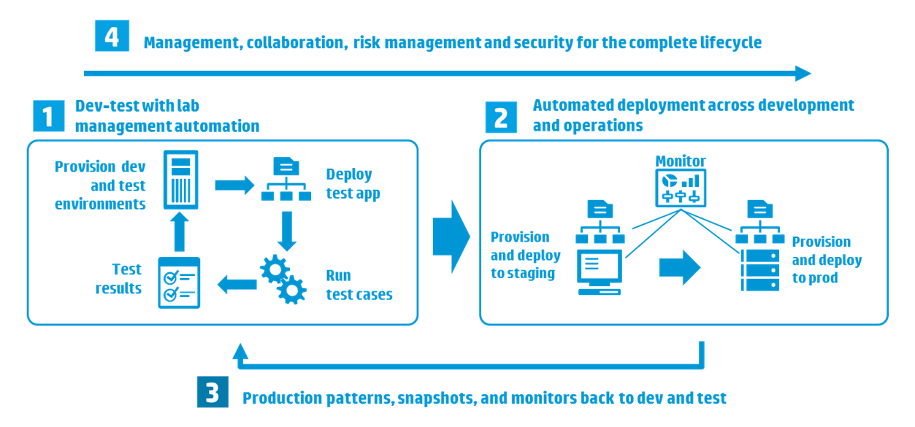
According to HP
Source: http://h30499.www3.hp.com/t5/Grounded-in-the-Cloud/Transform-DevOps-with-Application-Release-Automation/ba-p/5952497#.VZ7dGVxTUqg

Slide 24
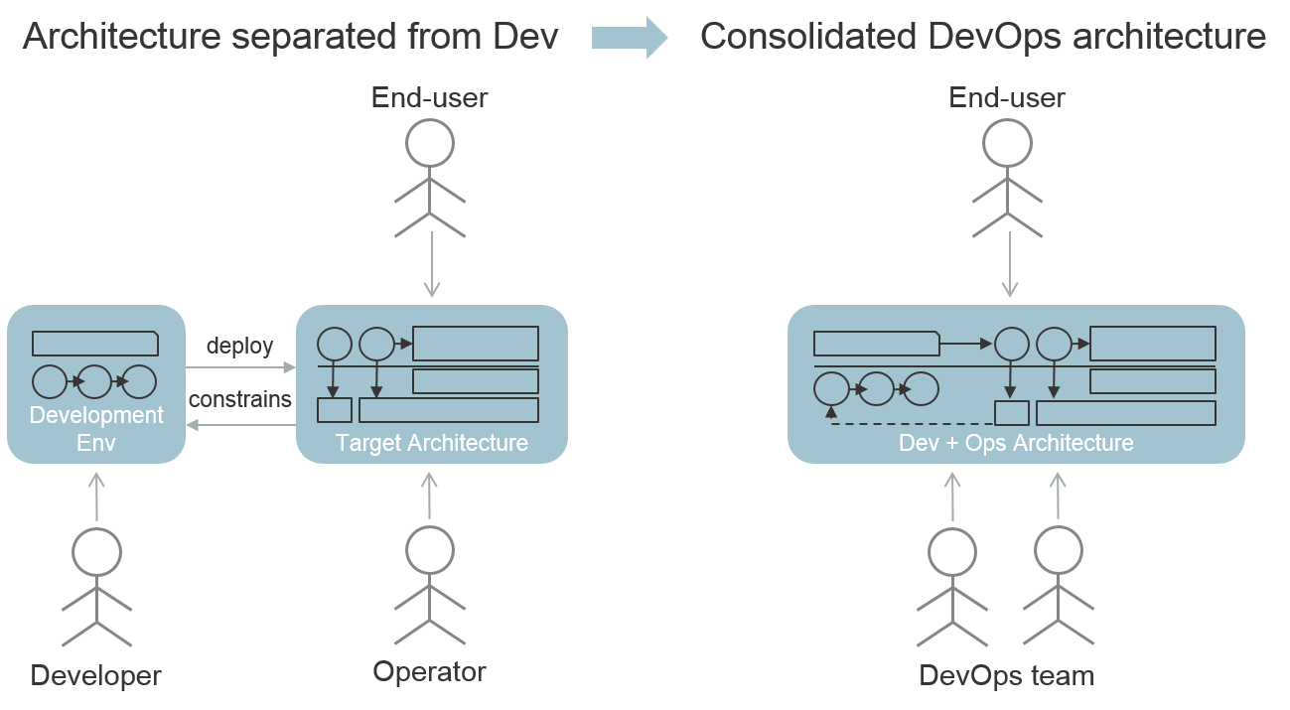
According to Eltjo
Source: http://eltjopoort.blogspot.com/2014/08/how-devops-impacts-architecture.html

Slide 25
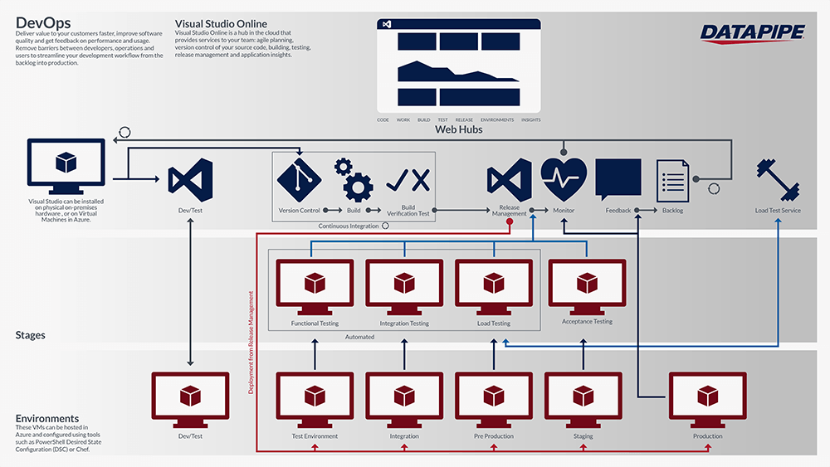
According to DATAPIPE
Source: https://www.datapipe.com/blog/2015/02/24/integrate-azure-into-your-devops-with-datapipe-managed-cloud-for-azure/

Slide 26
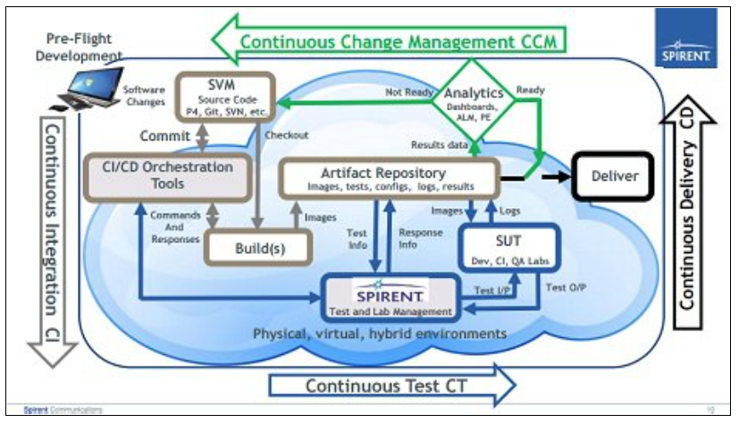
According to Spirent
Source: http://devops.sys-con.com/node/3359638

Slide 27
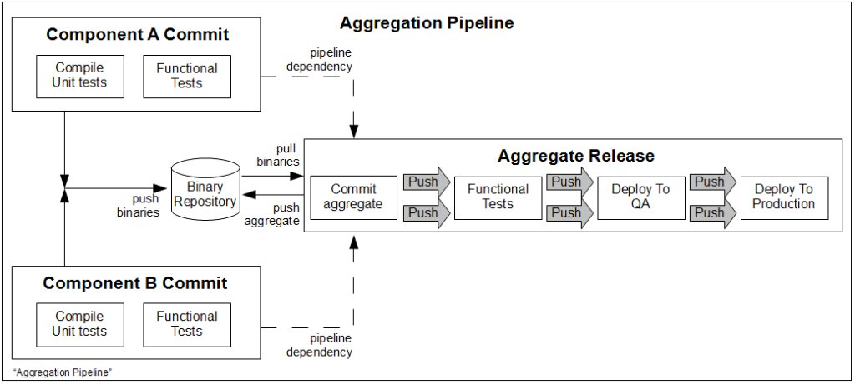
According to Always Agile
Source: http://www.alwaysagileconsulting.com/category/continuousdelivery/page/5/

Slide 28
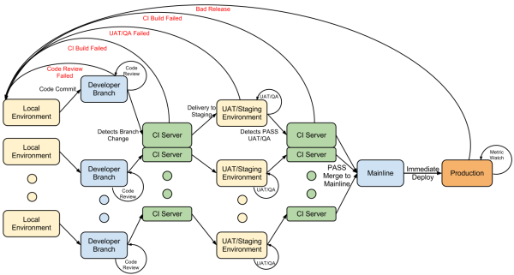
According to Assembla
Source: http://blog.assembla.com/AssemblaBlog/tabid/12618/bid/92411/Continuous-Delivery-vs-Continuous-Deployment-vs-Continuous-Integration-Wait-huh.aspx

Slide 29
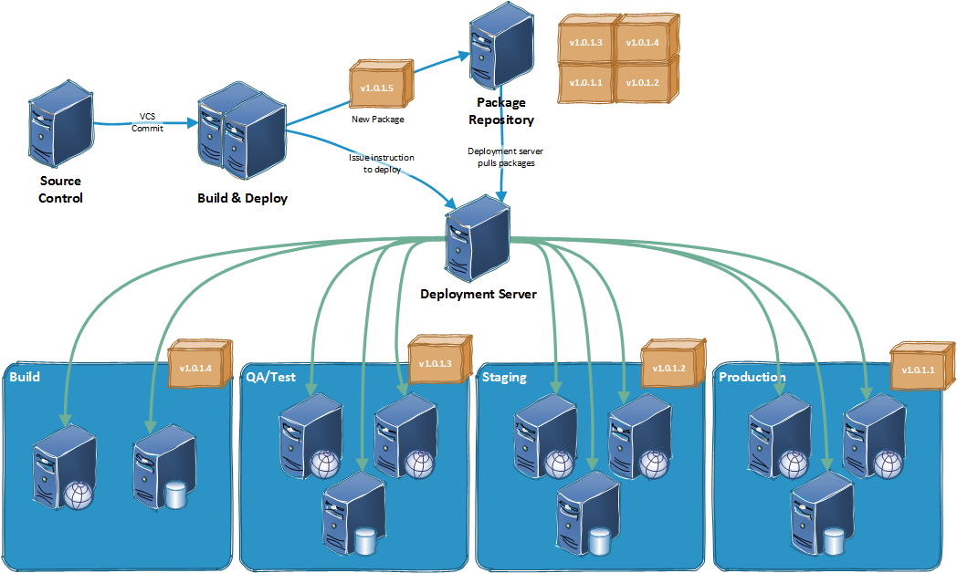
According to
Source:

Slide 30
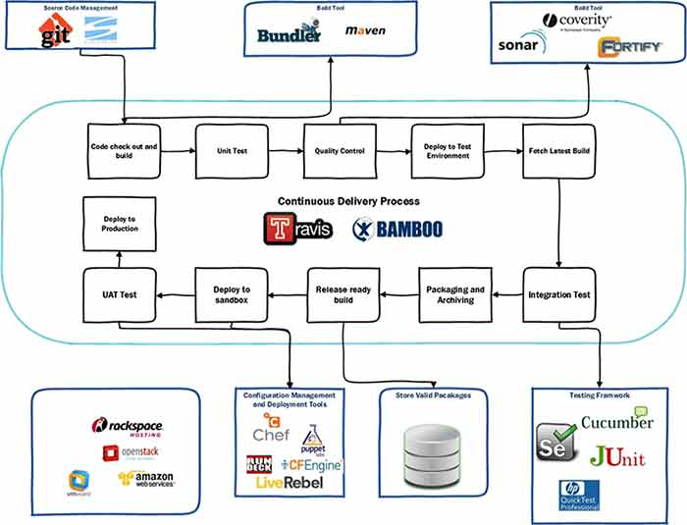
According to Girikon
Source: http://www.girikon.com/services/professional-services/devops-automation/

Slide 31
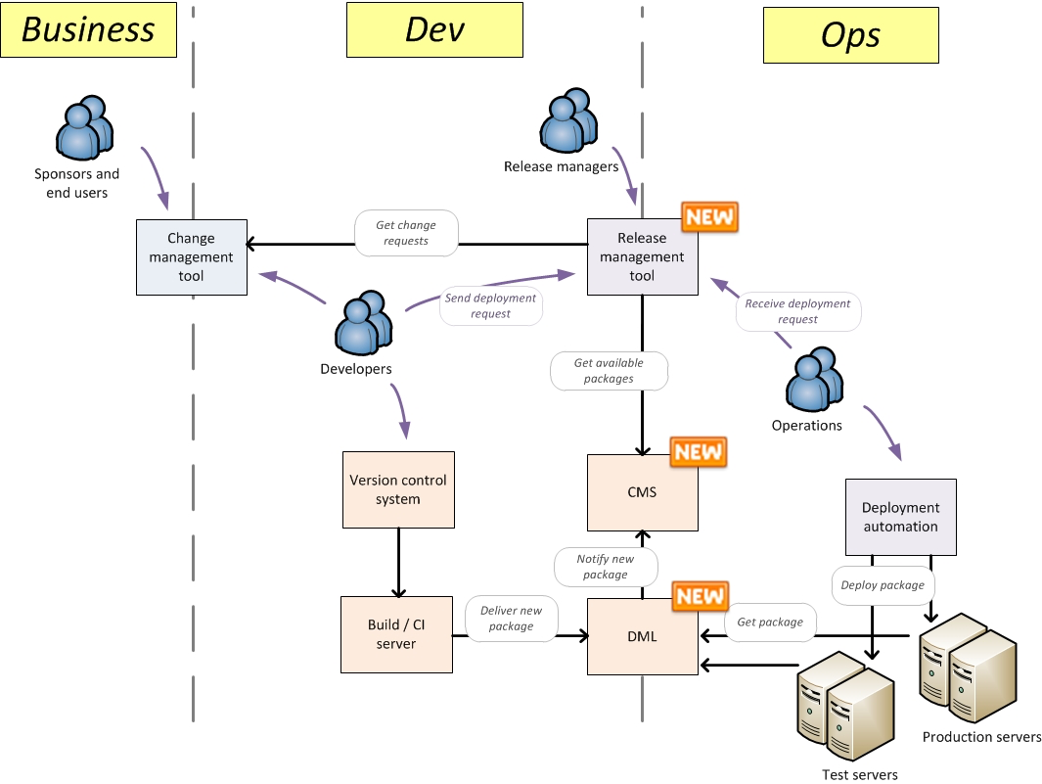
According to Bartholomeus
Source: http://niek.bartholomeus.be/category/devops/

Slide 32
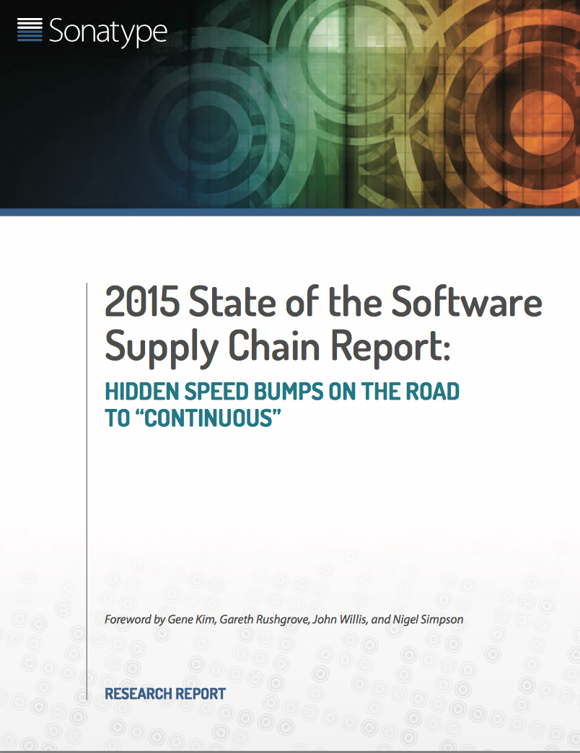

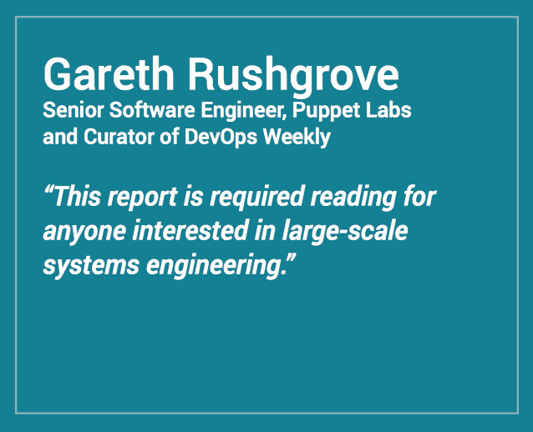
bit.ly/SoftwareSupplyChain
2015 State of the Software Supply Chain
Notes:
www.sonatype.org/nexus/
http://bit.ly/1Fc7BRV

Slide 33
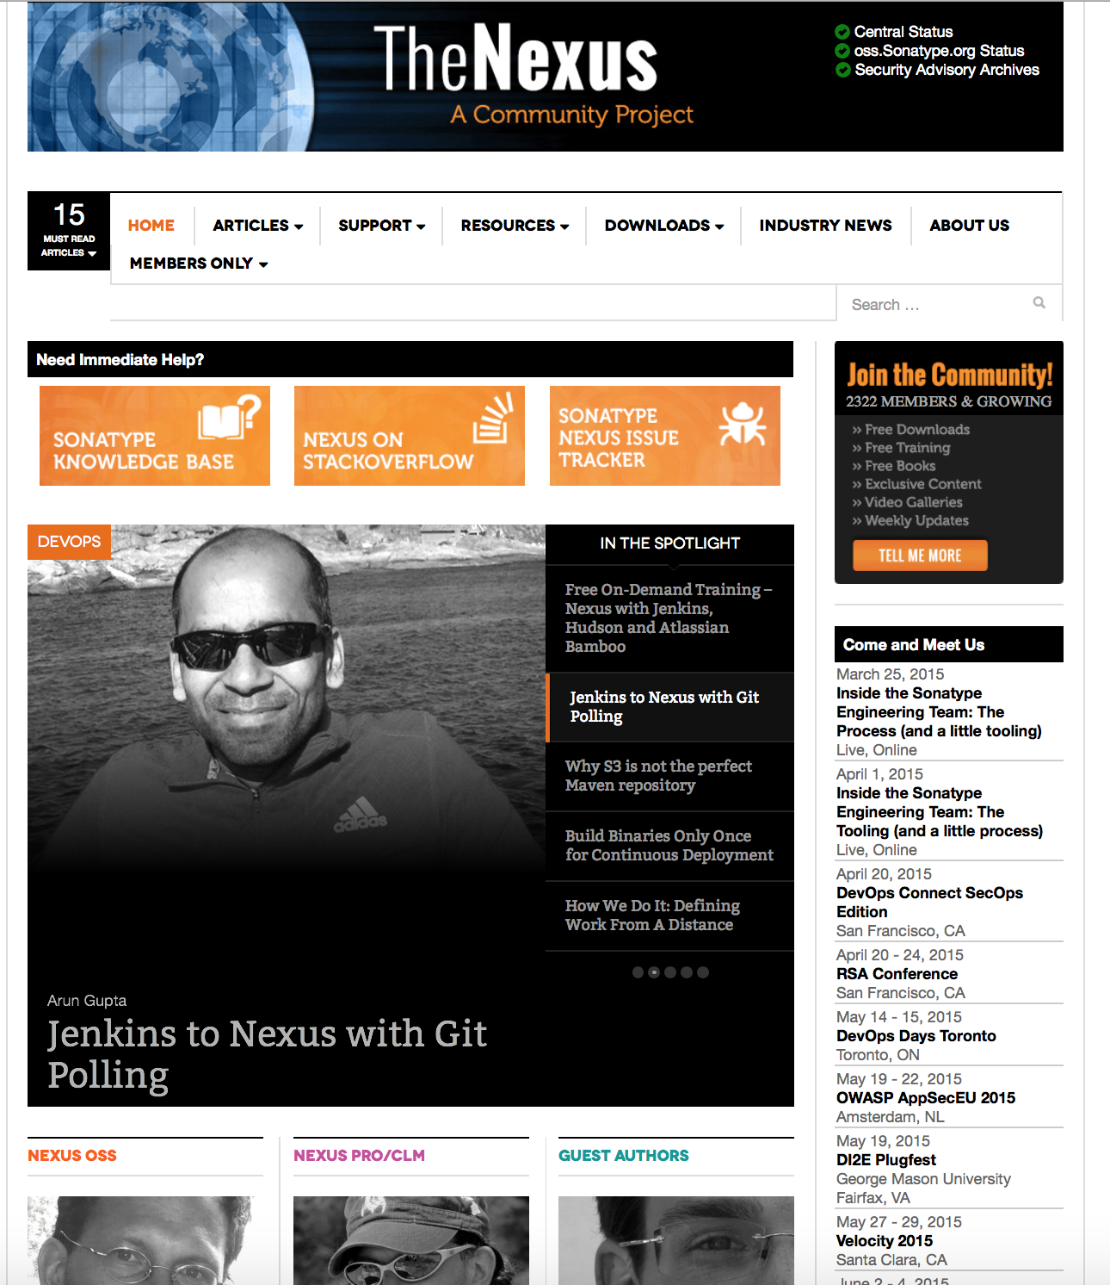
bit.ly/1Fc7BRV
Join the Conversation
Notes:
www.sonatype.org/nexus/
http://bit.ly/1Fc7BRV

Slide 34
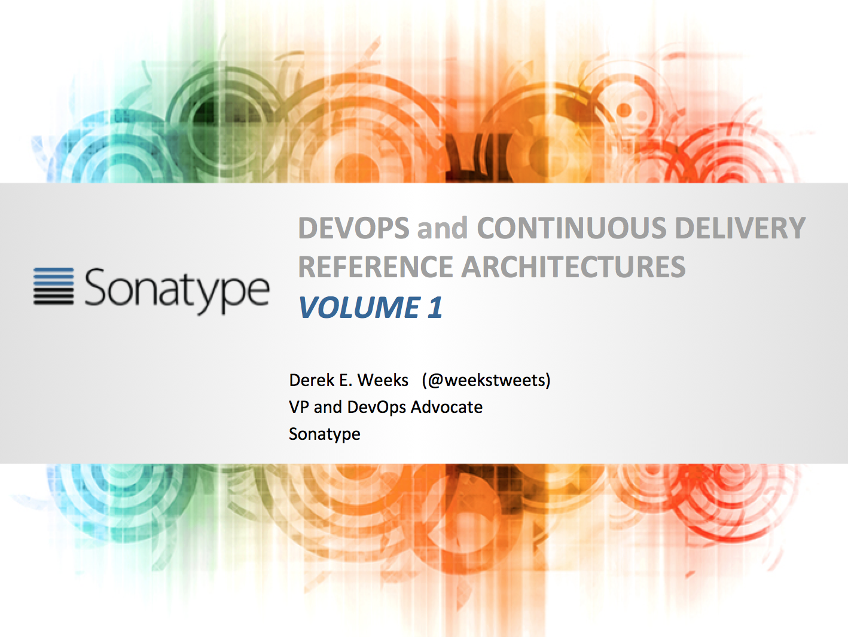
Check out Volume 1 at: bit.ly/1etAa2d
Want More?
Notes:
www.sonatype.org/nexus/
http://bit.ly/1Fc7BRV

